Slide 1
Doing Data Science - Midterm Project
Michael (Branum) Stephan and Yang Zhang
For a link to the rmarkdown, see link

Slide 2
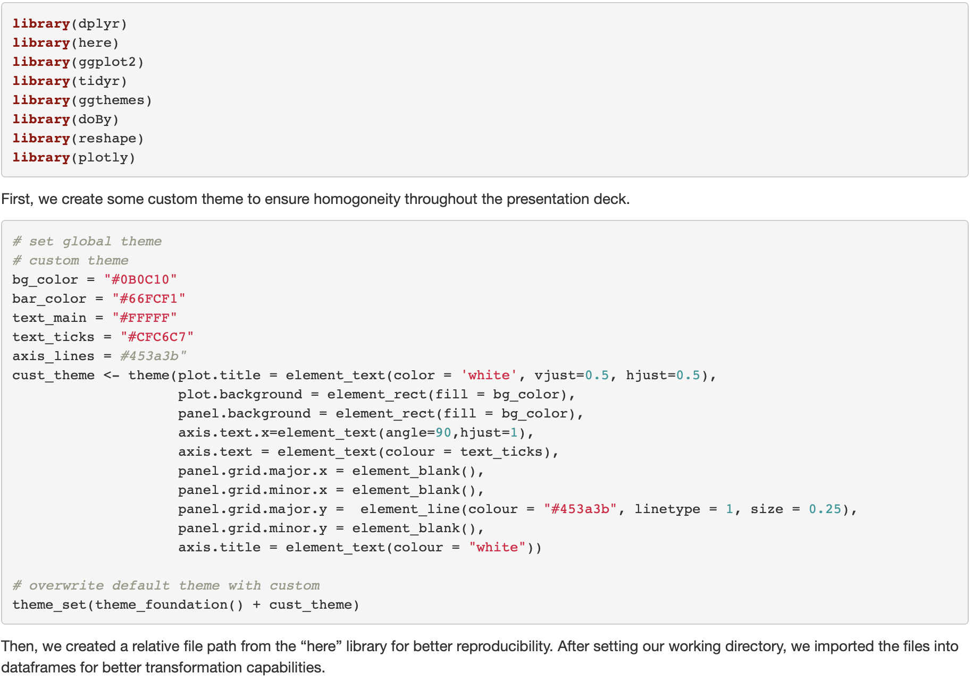
Defining a theme and importing libraries

Slide 3
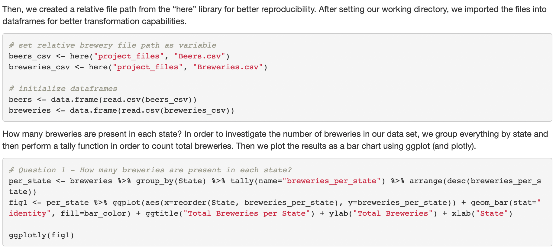
How many breweries exist per state?

Slide 4
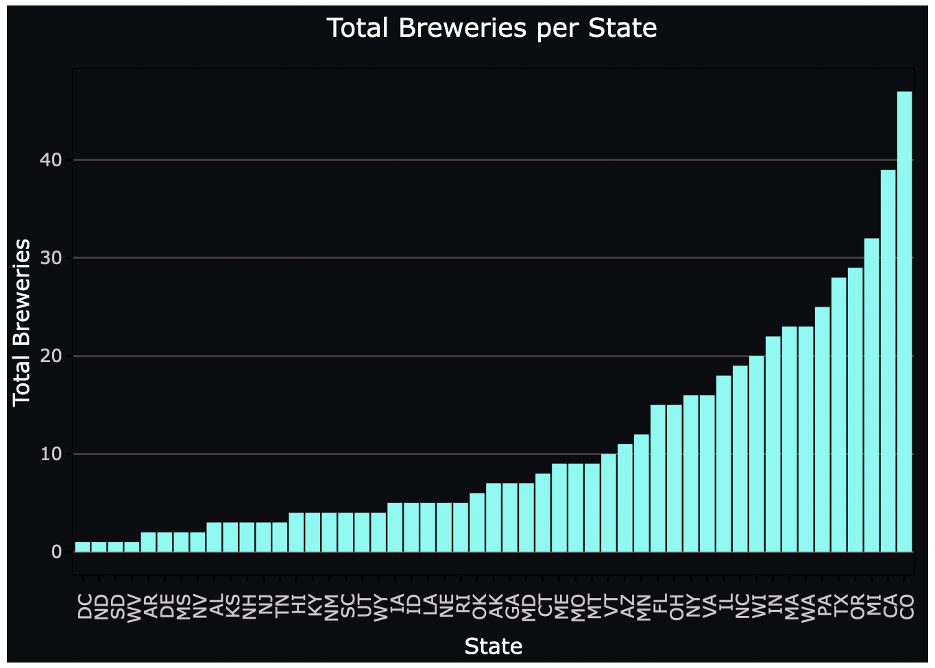
How many breweries exist per state?

Slide 5
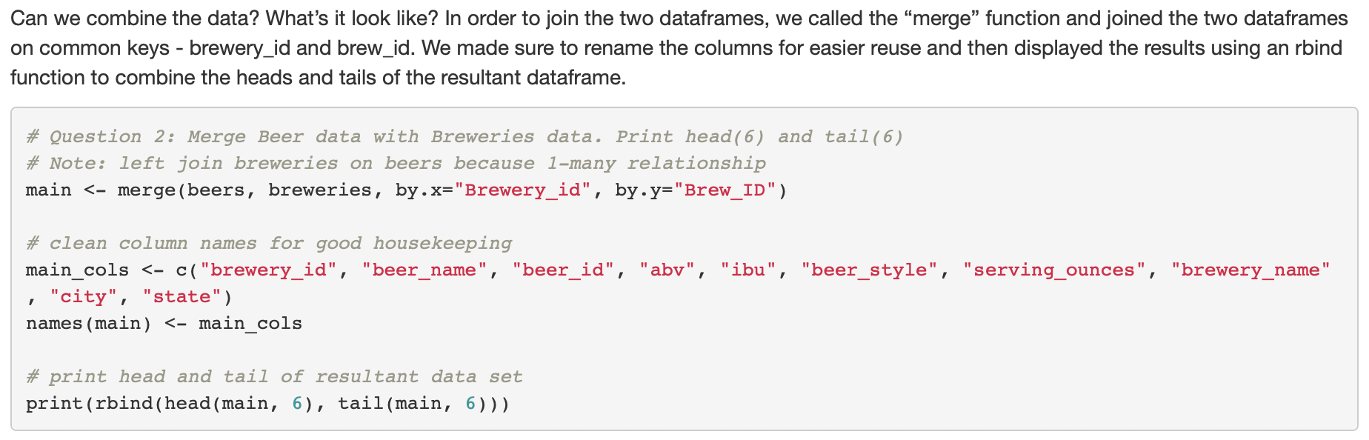
Combining the breweries and beer data

Slide 6
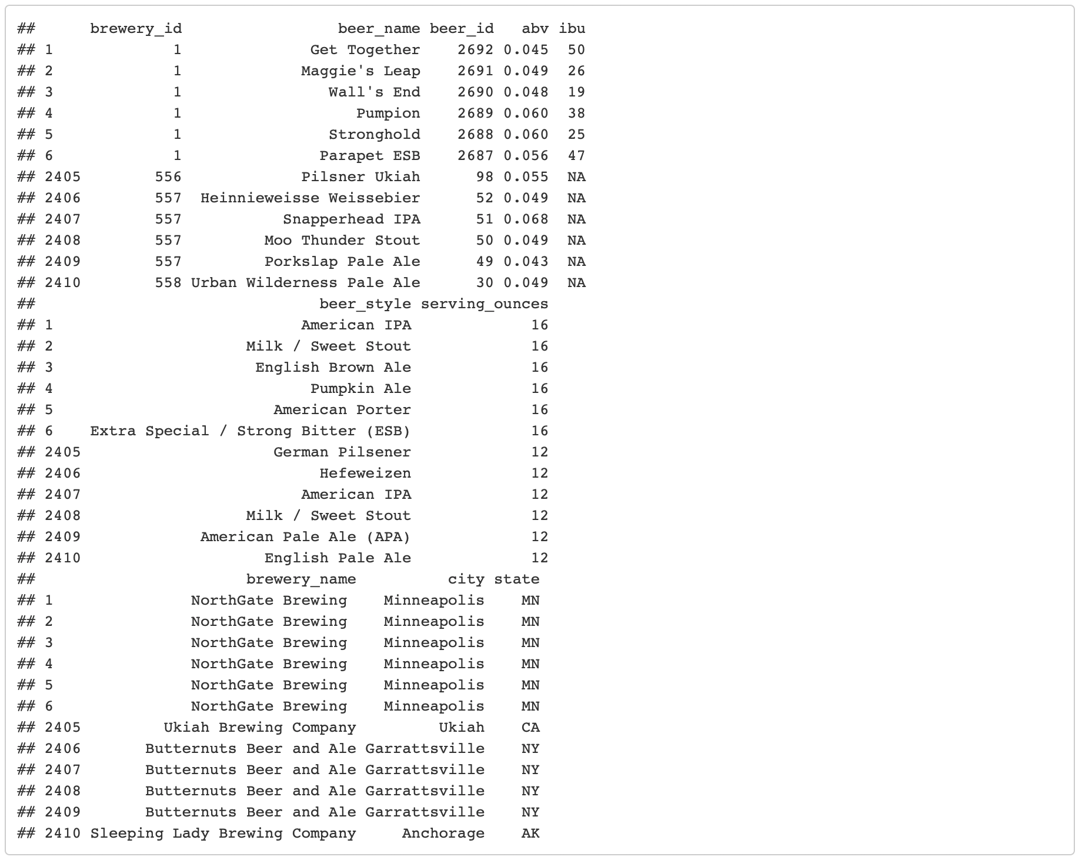
Combining the breweries and beer data

Slide 7
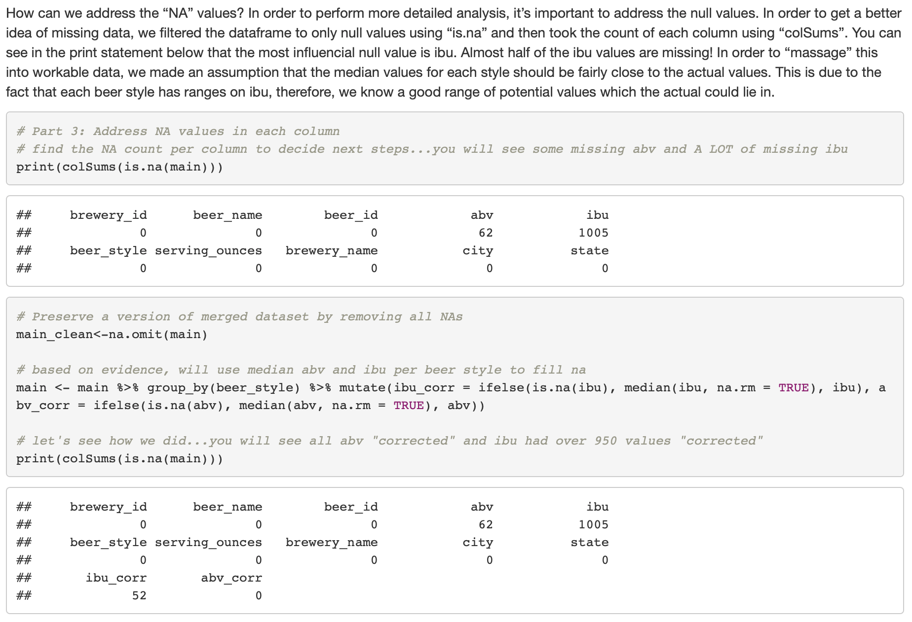
Dealing with ”NA” values

Slide 8
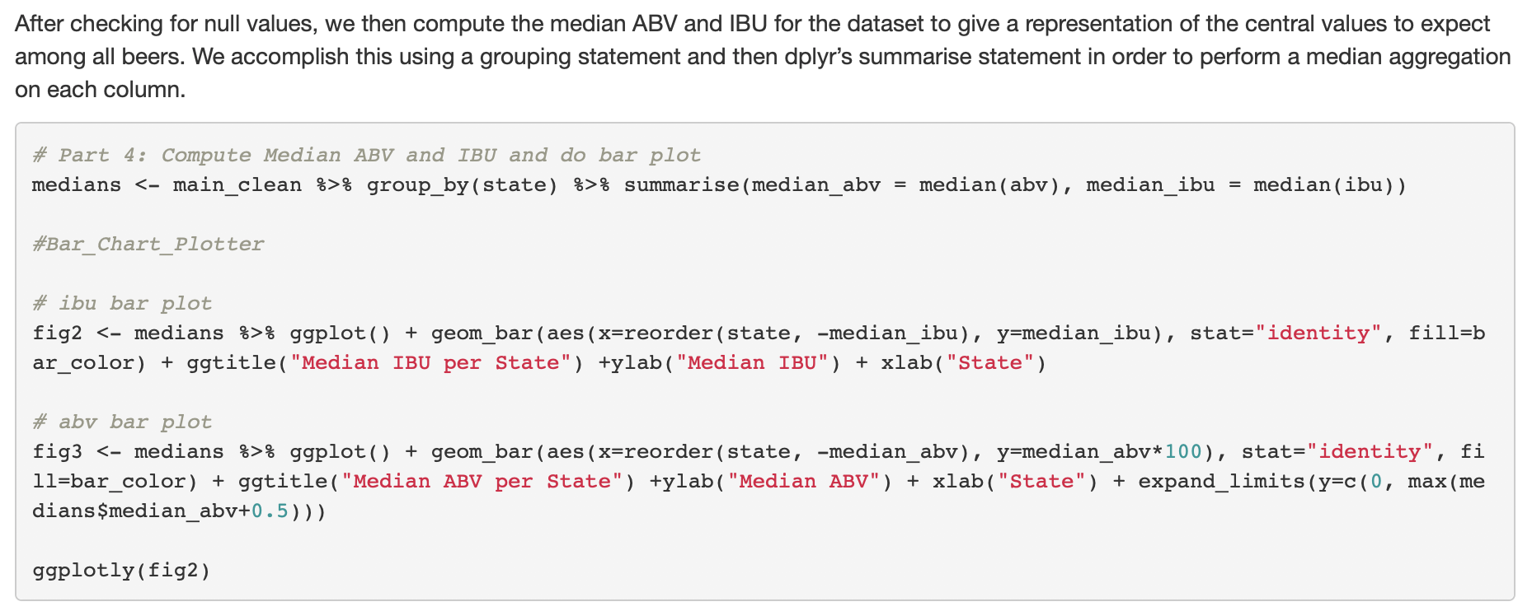
Dealing with ”NA” values

Slide 9
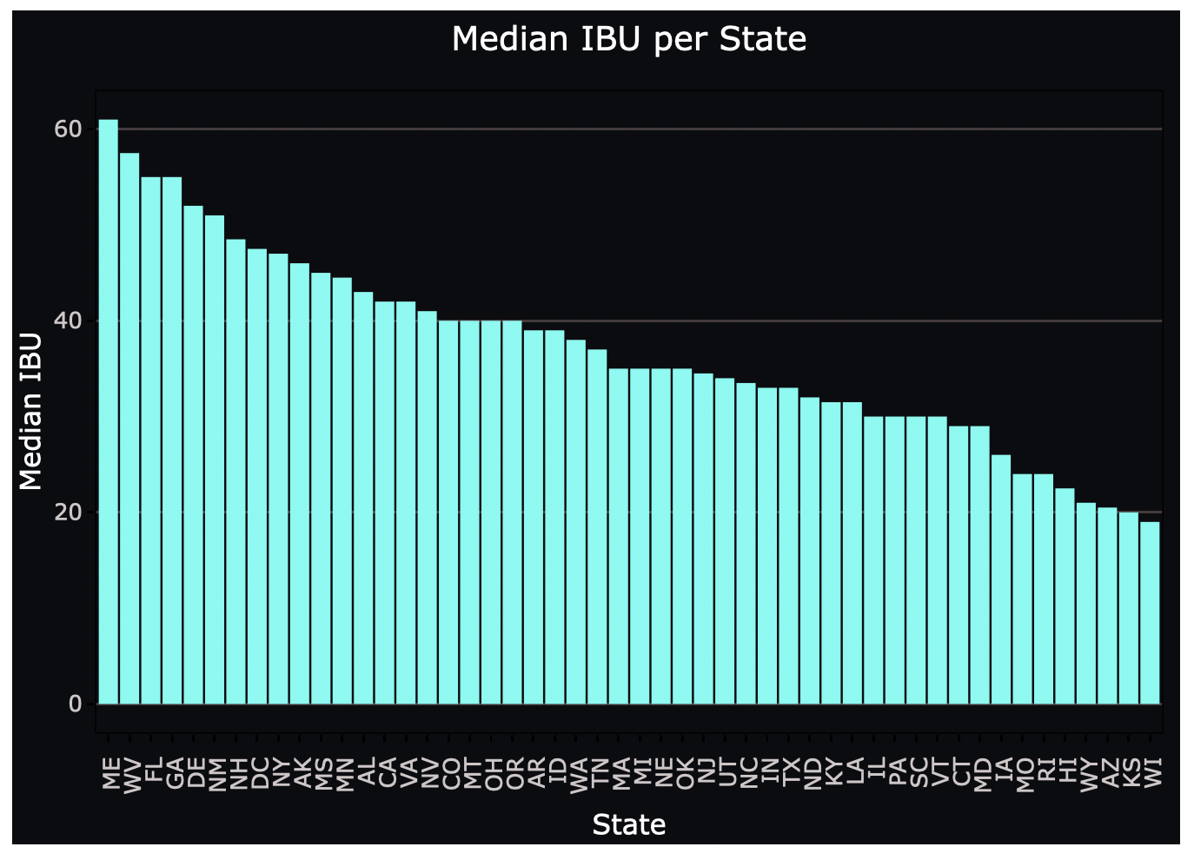
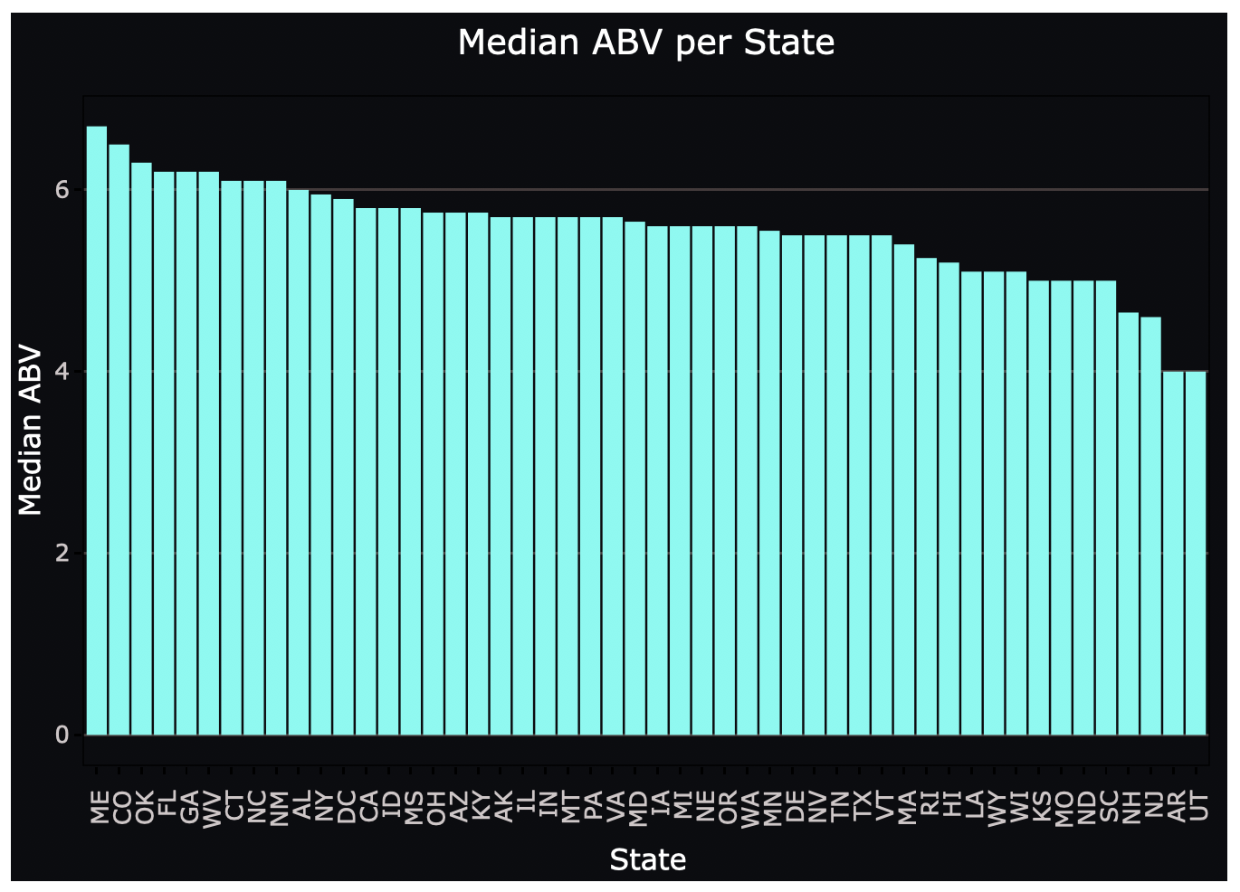
Median ABV and IBU per State

Slide 10
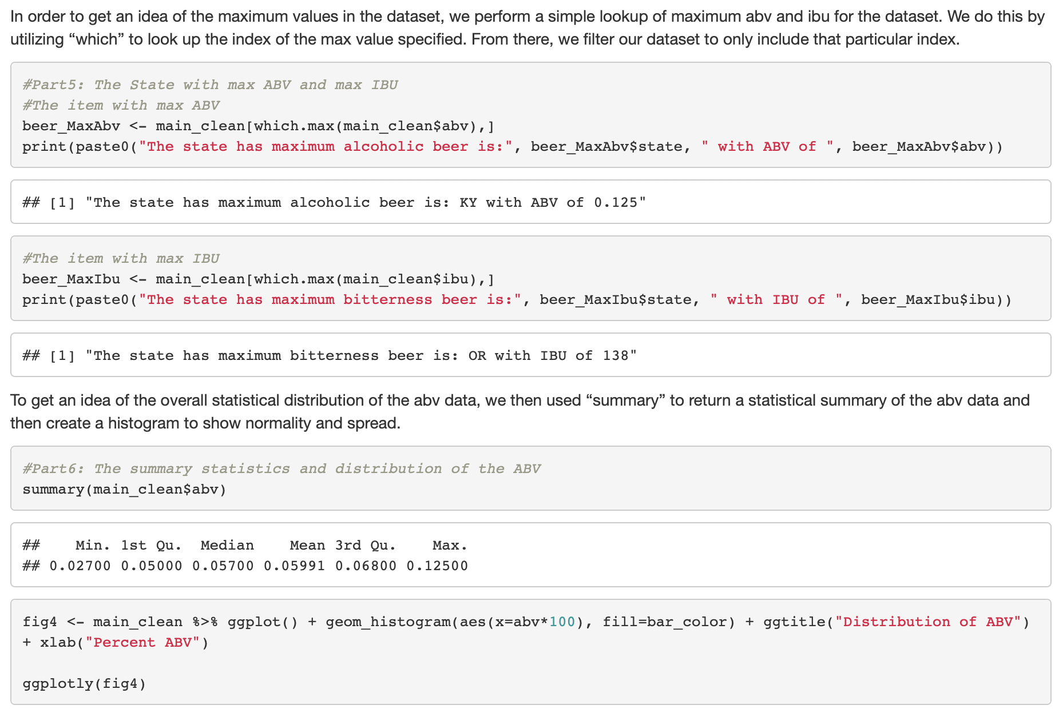
Maximum ABV and IBU per State

Slide 11
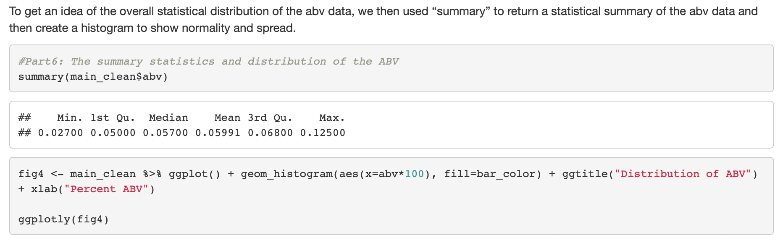
Distribution of ABV

Slide 12
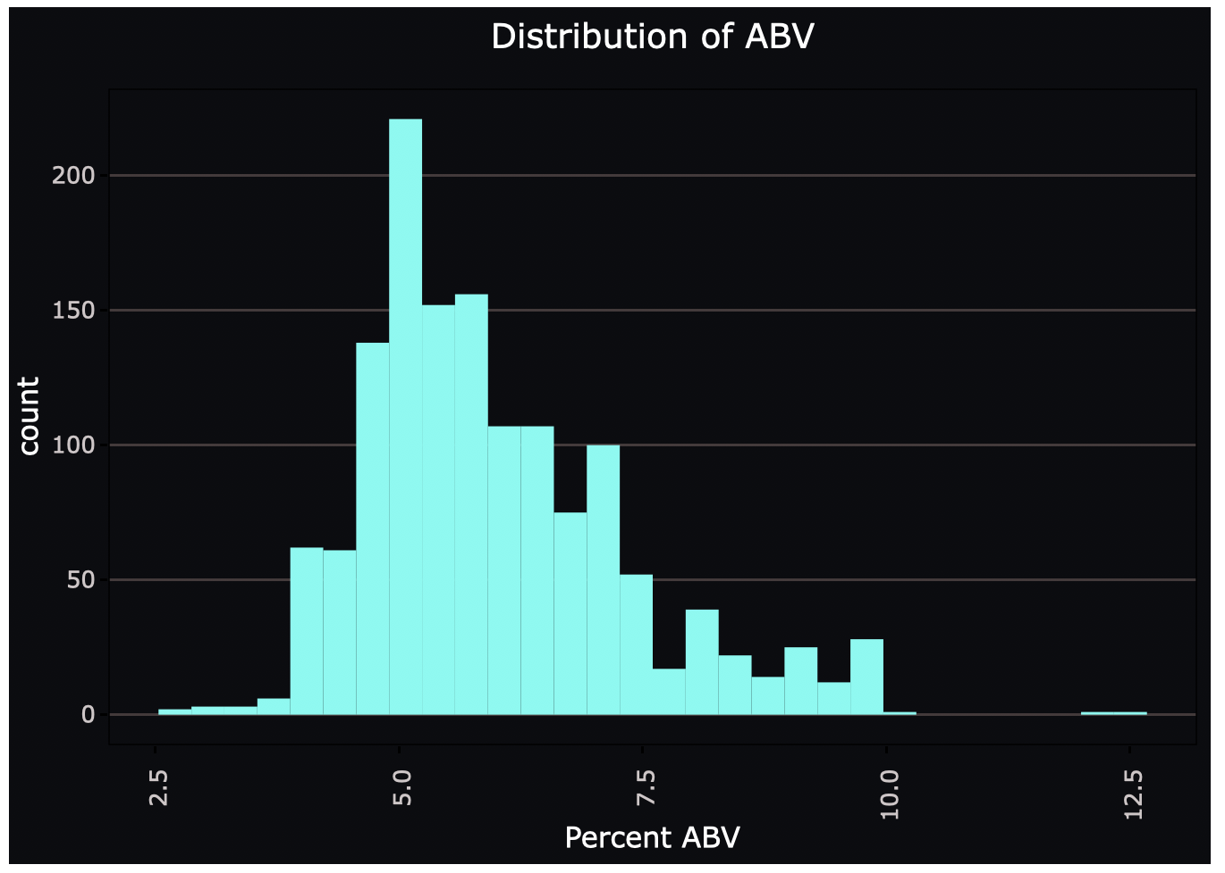
Distribution of ABV

Slide 13
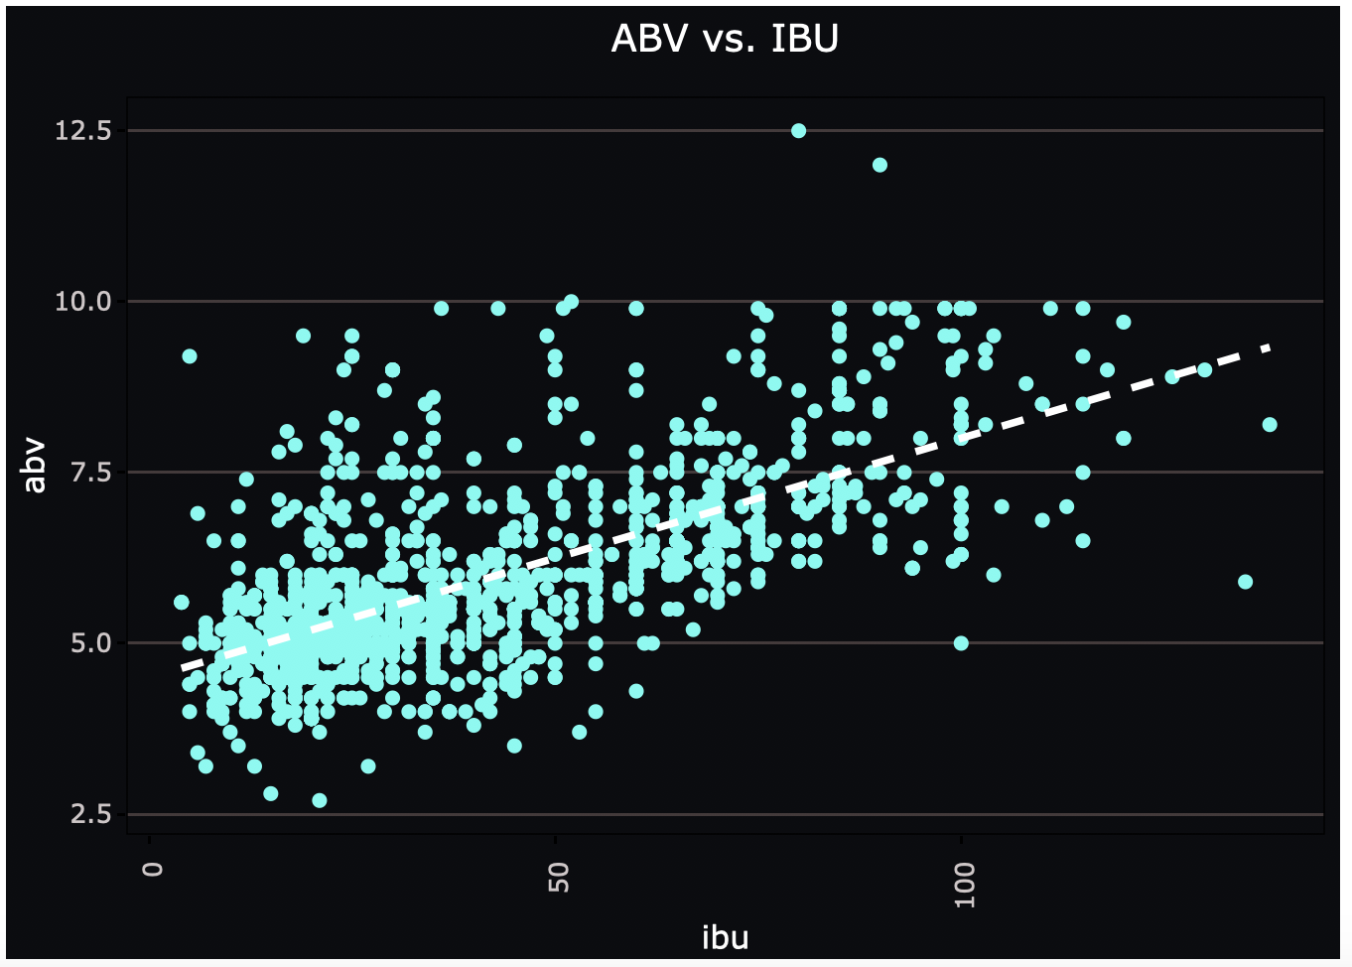
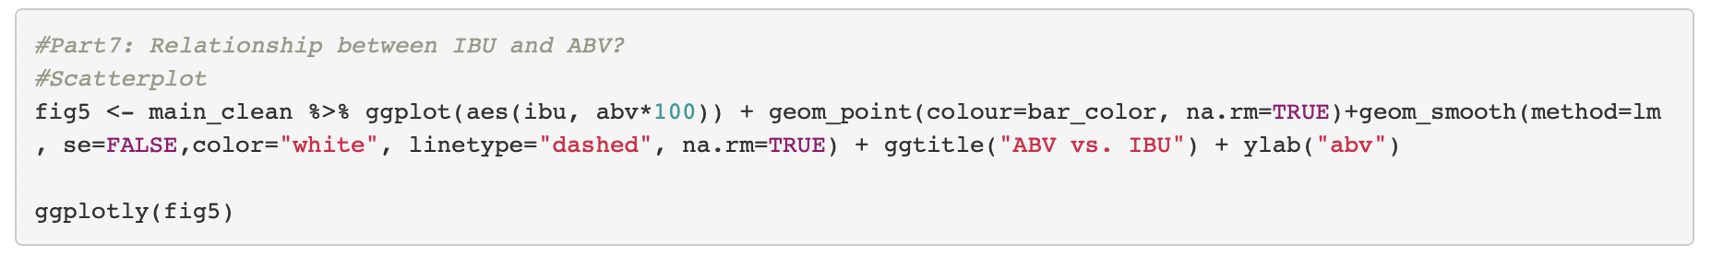
Correlation – ABV vs. IBU

